Slide 1
Algorithmic/Computational Thinking

Slide 2
Some quotes….
I really hate this damned machine
It never does quite what I want But only what I tell it.
~Anon
These machines have no common sense; they have not yet learned to think, and they do exactly as they are told, no more and no less. This fact is the hardest concept to grasp when one first tries to use a computer.
~Donald Knuth
Notes:
Some parting thoughts...Computers are really dumb. They can only do what we tell them to.

Slide 3
What's The Plan? Algorithmic/Computational Thinking
Step-by-step directions for whatever someone, or the computer, needs to do

Slide 4
Algorithm
A precise, systematic method for producing a specified result
In real life we do this all the time:

Slide 5
What is an algorithm?
Algorithms occur in many area of our lives outside the realm of computer programs. The most common description of an algorithm is a set of step-by-step directions that you give to someone else or publish in some way so that they can achieve the desired result.
Algorithm is a procedure and sequence of actions to accomplish some task. The concept of an algorithm is often illustrated by the example of a recipe, although many algorithms are much more complex; algorithms often have steps that repeat (iterate) or require decisions (such as logic or comparison). In most higher level programs, algorithms act in complex patterns, each using smaller and smaller sub-methods which are built up to the program as a whole.
Source: Computer User's online dictionary
A receipt is a common algorithm. In a recipe you may repeat a step over and over. For instance, giving directions for peeling a single carrot and then slicing it until all the carrots are peeled and sliced. You may have logical branches. For instance, if the tomatoes have dark spots, dig them out with a knife and throw them away. If the tomatoes do not have dark spot, continue on to the next step.
Repetition and logical branches are some of the common concepts of computer programs as well. In the next module, we’ll start our exploration of the concepts common to all computer programs. For this module, we’ll focus on algorithmic thinking.
Notes:
Algorithms occur in many area of our lives outside the realm of computer programs. The most common description of an algorithm is a set of step-by-step directions that you give to someone else or publish in some way so that they can achieve the desired result.
A receipt is a common algorithm. In a recipe you may repeat a step over and over. For instance, giving directions for peeling a single carrot and then slicing it until all the carrots are peeled and sliced. You may have logical branches. For instance, if the tomatoes have dark spots, dig them out with a knife and throw them away. If the tomatoes do not have dark spot, continue on to the next step.
Repetition and logical branches are some of the common concepts of computer programs as well. In the next module, we’ll start our exploration of the concepts common to all computer programs. For this module, we’ll focus on algorithmic thinking.

Slide 6
Algorithms in our everyday lives
Directions to our home, workplace, or the shopping mall to meet friends
Recipes
Patterns
For sewing clothes or soft furnishings
For knitting or crochet
Plans for building furniture
Owners’ manuals
Notes:
Common algorithms in our daily lives include giving directions for driving somewhere, baking a chocolate cake, sewing doll clothes, knitting a scarf, building a futon frame, or adding RAM to your computer.

Slide 7
Algorithms in our everyday lives
Each algorithm
Each algorithm solves a problem or answers a question.
Each set of directions can be repeated with the same, or similar, results, depending on how well it’s written.
Can be repeated over and over
With the same results
We’ll look at some of the difficulties and some of the rules and guidelines for writing a good algorithm.
When we create an algorith, either written or oral, we always consider our audience. We give different driving directions to someone who is driving to Kızılayfrom campus.
When you surf for directions on how to add RAM to your laptop, the directions usually assume that you’re already fairly technically competent but not as knowledgeable as assumed for someone who is replacing their system’s motherboard.
Notes:
Each algorithm solves a problem or answers a question. Each set of directions can be repeated with the same, or similar, results, depending on how well it’s written. We’ll look at some of the difficulties and some of the rules and guidelines for writing a good algorithm.

Slide 8
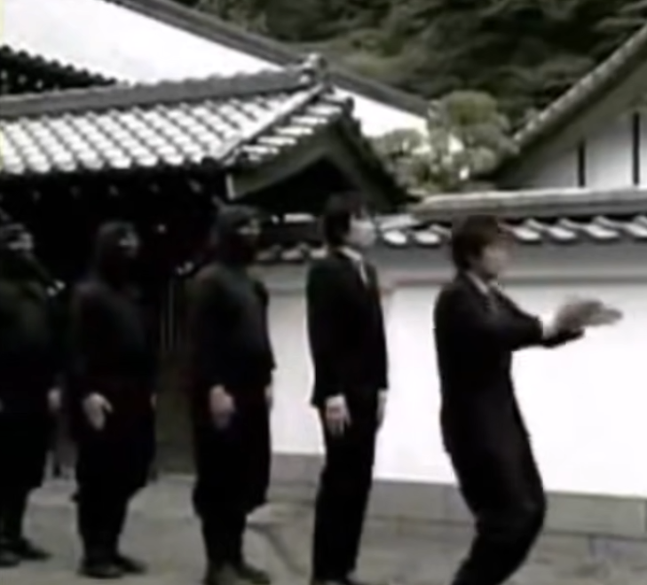
Video
Algorithm example

Slide 9
Algorithms in our everyday lives
Always consider the audience
Is your friend familiar with Kızılay?
How much experience with baking does your friend have?
If you’re going to add RAM to your laptop yourself, you’re probably fairly technically competent
Notes:
When we create an algorith, either written or oral, we always consider our audience. We give different driving directions to someone who is driving to North Seattle from Kent or Tacoma or Boise than to someone living in the dorms on campus. We given different directions in a recipe to a new cook than to Aunt Martha who’s been baking for 40 years. When you surf for directions on how to add RAM to your laptop, the directions usually assume that you’re already fairly technically competent but not as knowledgeable as assumed for someone who is replacing their system’s motherboard.

Slide 10
Language in Algorithms
Natural language (People speak in what we call natural language)
For people, we use a natural language like English
Ambiguity is common in natural language (Each word in a computer language, even if it looks like English, has a much narrower, more precise meaning that the computer understands.
Programming Language
Formal languages designed to express algorithms
Precisely defined; no ambiguity
Notes:
Let's look at language in algorithms. People speak in what we call natural language. We may give our phone number to someone as 2-oh-6-543-43-oh-4 or we may say 2-zero-6-543-43-zero-4. Whoever you're talking to understands.
If you said it the same way to a computer that could understand spoken language, the computer might understand "oh" and "zero" but if the programmer stated that the phone number field contains only numbers. However, if the "oh" was in the email address field, where both numbers and letters are allowed, the computer would not understand.
So you can see that ambiguity of this type in fine in natural languages but that computer languages must be defined much more precisely. Each word in a computer language, even if it looks like English, has a much narrower, more precise meaning that the computer understands.

Slide 11
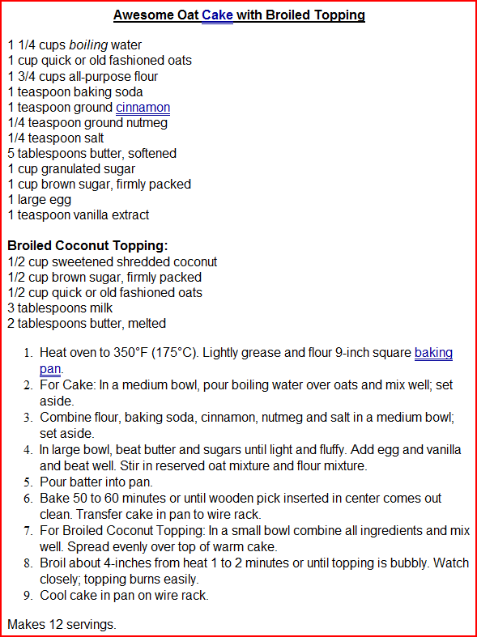
How are algorithms organized?
Title
Ingredients
Title
Notes:
Let’s look next at how algorithms are organized by considering a recipe. It has a title.

Slide 12
How are algorithms organized?
Title
Ingredients
Steps
Notes:
Steps to follow….

Slide 13
How are algorithms organized?
Title
Ingredients
Steps
Servings
Notes:
Yield, that is how many servings the recipe will make when you’re done.

Slide 14
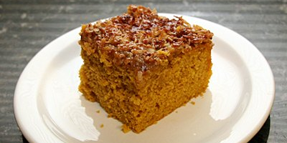
How are algorithms organized?
Title
Ingredients
Steps
Exceptions
Servings
Notes:
If we look more closely, we’ll see that exceptions are handled. If you don’t have quick oats on hand, you can use old-fashioned oats and know that the recipe will turn out okay.

Slide 15
How are algorithms organized?
Title
Ingredients
Steps
Exceptions
When to stop
Servings
Notes:
Note that recipes always have a stopping point somewhere in the steps of the procedure. "Bake 50-60 minutes or until wooden pick inserted in center comes out clean." This direction also handles exceptions. The oven in Step 1 was heated to 350 de. F. but what if your oven is hotter or colder than the test oven? What if you are in the Rocky Mountains or Sea Level? Any of these exceptions is handled with "Bake 50-60 minutes or until wooden pick inserted in center comes out clean." It makes all of these circumstances unimportant. It takes care of all these various circumstances by letting you know that the cake is done when the wooden pick comes out clean.
Now we’ll look at how what we’ve just looked at is formalized into the Five Essential Properties of an Algorithm.

Slide 16
The Five Essential Properties of Algorithms
Input specified
Data to be transformed during the computation to produce the output
Must specify type, amount, and form of data
Output specified
Data resulting from the computation—intended result
It is possible to have no output
Notes:
First, we specify inputs and outputs. Think of an algorithm as a black box. Inputs go into the black box. Output comes out. In the black box, all the processing magic takes place.
In a recipe the inputs are the ingredients, specified exactly: 1¼ cups boiling water, 1 tsp. vanilla extract, etc. The output is the yield: 12 servings.
In the next module, we’ll learn about data types that are used in computer programs.

Slide 17
Five Essential Properties (cont'd)
3. Definiteness
Specify the sequence of events
Details of each step, including how to handle errors
4. Effectiveness
The operations are do-able
5. Finiteness
Must eventually stop
Notes:
What happens inside the black box, the steps, is covered by the next three properties. Definiteness specifies the sequence of events with details, and how to handle exceptions---”Bake for 50-60 minutes or until wooden pick inserted in center comes out clean.”
Effectiveness makes sure that each step is doable. You don’t see recipes calling for cream instead of butter and then giving steps for clabbering it into butter in modern recipes for city kitchens. When you give driving directions, you don’t say in downtown Seattle, head West on Pine until you reach Olympic National Park. There’s a slight gap in those directions unless you are driving a duck that can go from land to sea to land again.
The fifth essential property is finiteness. Finiteness being the opposite of infinity. You have to say when to stop. You don’t keep baking a cake forever unless the intended yield is charcoal! If so, you’d better include steps for a fire extinguisher as well!

Slide 18
Context matters—sorting names
Program can fulfill five properties of an algorithm, be unambiguous, and still not work right because it is executed in the wrong context
e.g., last name in Western countries means family name; in Asian countries it may mean given name
Notes:
In addition, context matters. If the proper context isn’t considered the algorithm may fail. If you tell a program to sort names by last name, that sequence of instructions will work correctly in Western countries but in some Asian countries the list may end up sorted by given name instead of family name because names are listed in the opposite order with given name last and family name first.
If you tell an ATM to dispense two $20 bills, that’s okay in the U.S. but may cause a few problem in the UE!! If you give the directions on the ATM only in English, that may be a problem in Quebec or Madrid or Sao Paolo.

Slide 19
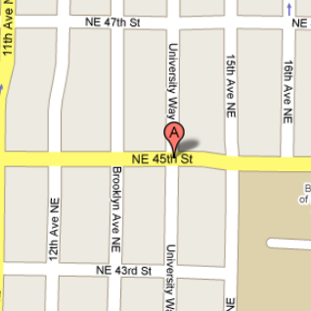
Context matters—driving instructions
Driving instructions "From 45th go to University Avenue and turn right."
Assumes you are traveling in a specific direction. If you are not, the directions will fail.
Diagram of approaching a street (the Ave) from different directions, giving the "turn right" instruction different meanings
Notes:
If you give driving directions, and say turn right at the corner, if you haven’t specified from which direction you are approaching the corner, “We have a problem, Houston!” The direction you’re traveling makes a difference when you get to that corner!

Slide 20
Context matters—bread ovens
When you’re baking, it makes a difference what kind of oven you are using.

Slide 21
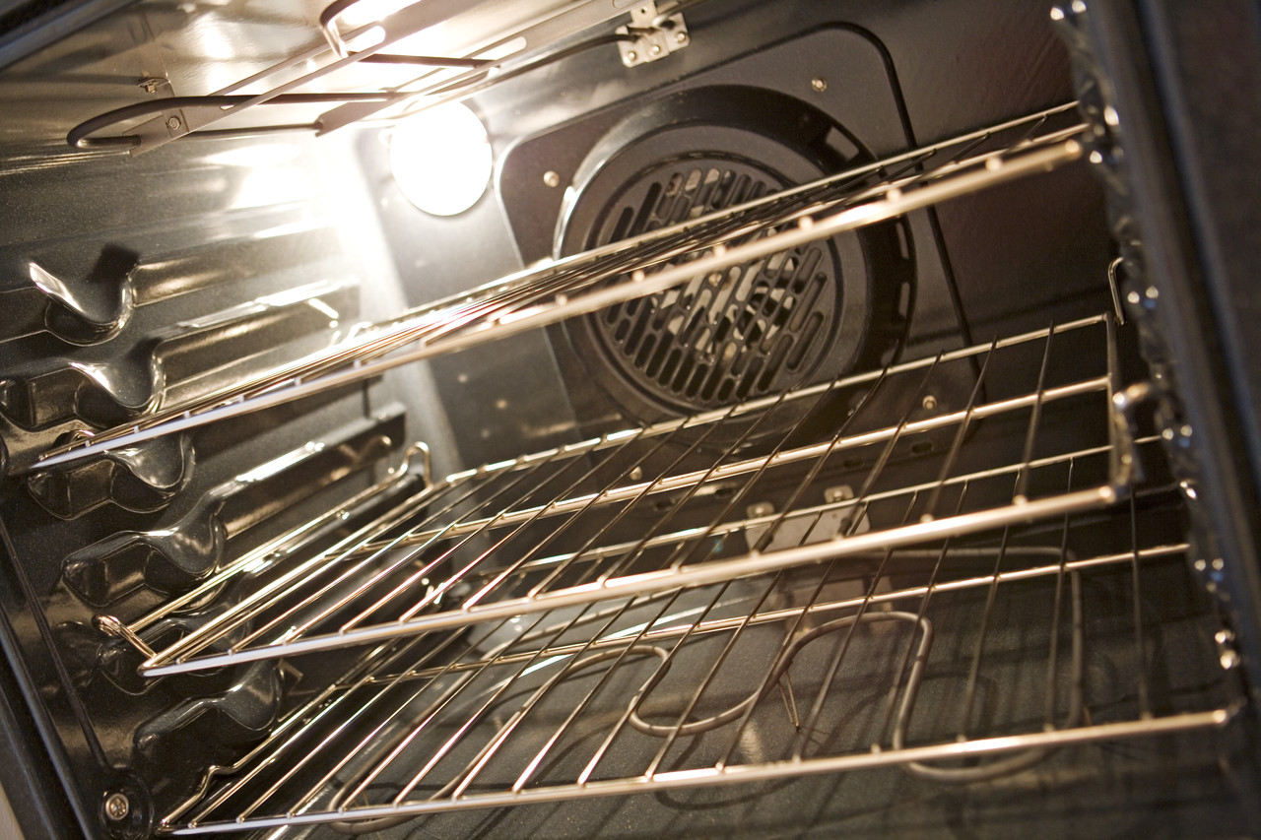
Context Matters—electric ovens
Notes:
A modern electric oven or a

Slide 22
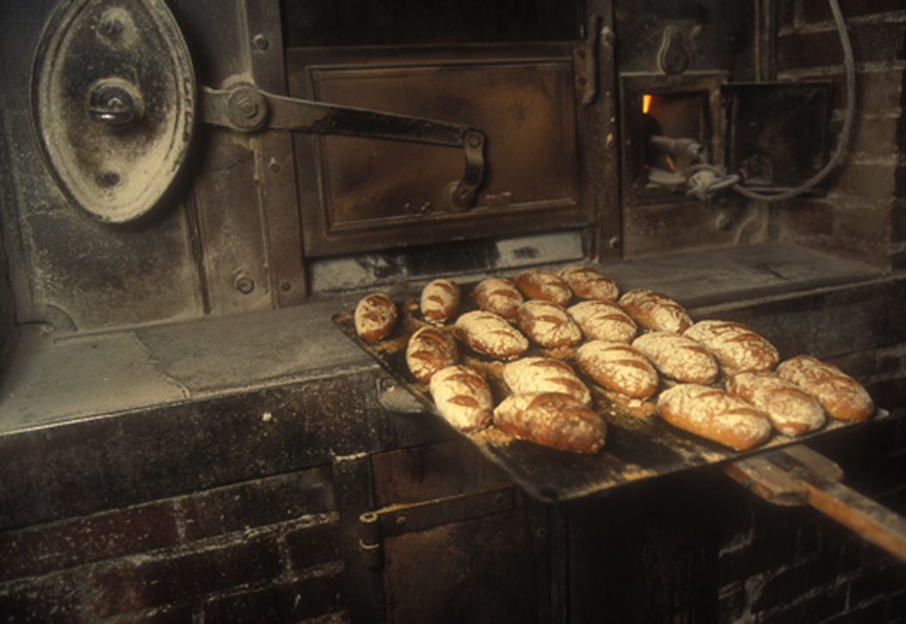
Context Matters—brick ovens
Notes:
brick bake oven like the bread-baking ovens in France.

Slide 23
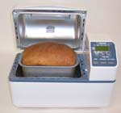
Context matters—bread machine
Notes:
Or a countertop bread machine like this one.

Slide 24
Program vs. Algorithm
A program is an algorithm that has been customized to
solve a specific task
under a specific set of circumstances
using a specific language
Algorithm is general
Program is specific
Notes:
Context is the main difference between programs and algorithms. A program has been written specifically for a particular computer software program, such as JavaScript or C#. For a cash machine, it would be written as well for a particular human language—American English or Canadian French or both—and currency—U.S. dollars or Canadian dollars or euros.

Slide 25
A practice algorithm…
Grab a piece of paper
In the next few slides, I’ll name the property of an algorithm and you can fill in the blanks for making a salad.
Notes:
So those are the five essential properties of an algorithm. Now we’ll look at them in terms of another recipe, making a salad. Get out a piece of paper and jot down each property. Pause the slides as you take time to consider and write the details for that property.

Slide 26
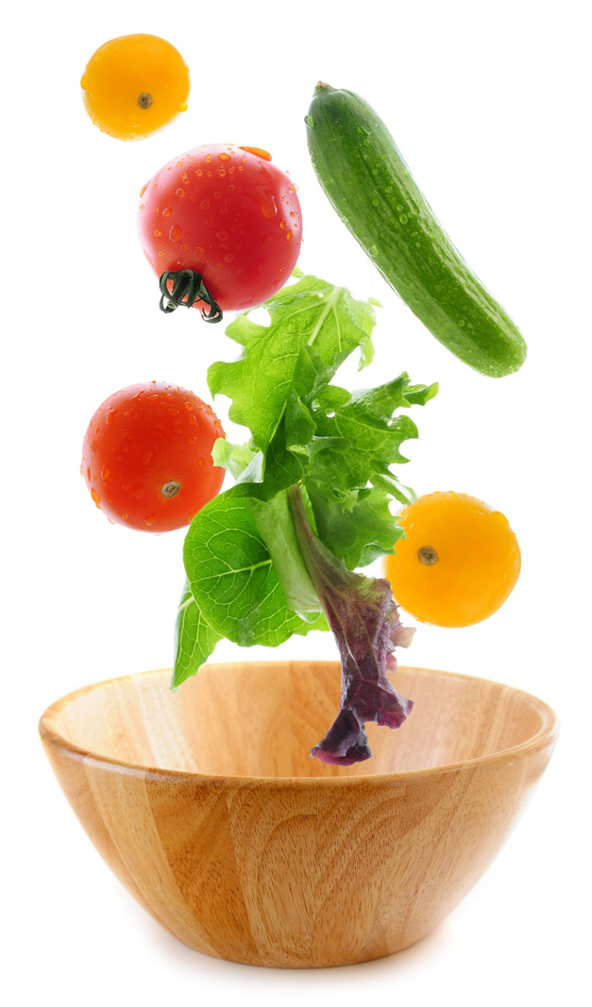
Algorithm: Input specified
Algorithm for preparing a salad
Input specified
Notes:
List all the ingredients and their quantities for the specified input.

Slide 27
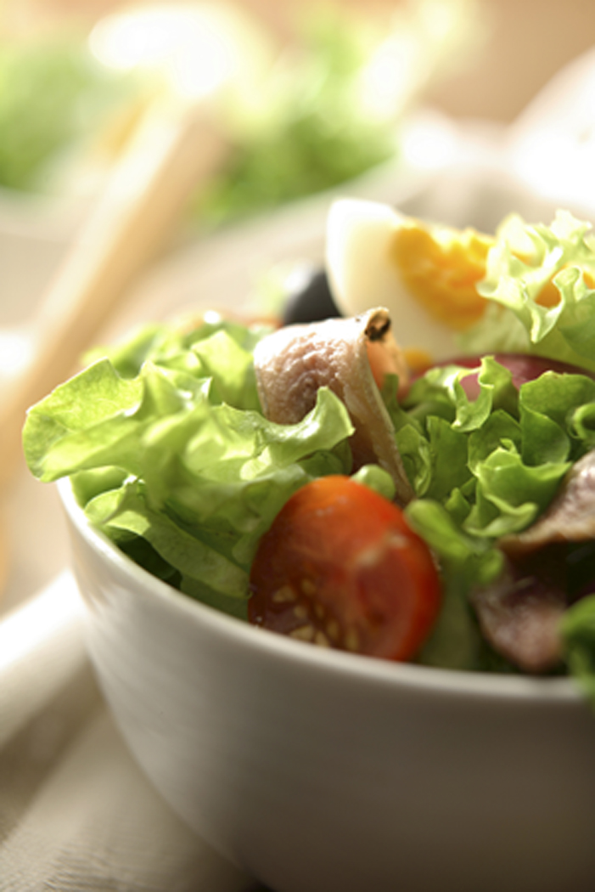
Algorithm—Output specified
Algorithm for preparing a salad
Output specified
Notes:
Describe the specified output, or yield in recipe speak.

Slide 28
Algorithm— Definiteness & Effectiveness
Algorithm for preparing a salad
Definiteness
Effectiveness
Notes:
Write out the steps, making sure you follow both definiteness and effectiveness. Recall that definiteness puts the steps in sequence, makes them precise, and handles any exceptions while effectiveness makes sure they are doable.

Slide 29
Algorithms--Finiteness
Algorithm for preparing a salad
Finiteness
Notes:
Write out the final step that makes sure the process ends. What is the final step?

Slide 30
Exchange Sort Algorithm
Exchange sort algorithm

